Slide 1
Quantum Navigation System
Integrating ROS2, ML, and Quantum Computing for Smart Robotics

Slide 2
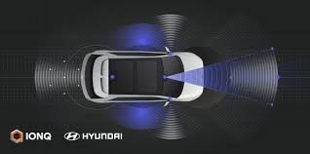
Introduction
This presentation explores a Quantum-Based Autonomous Navigation System, leveraging technologies like ROS2, ML, and quantum computing to enhance robotic navigation efficiency and safety.

Slide 3
01
Project Overview

Slide 4
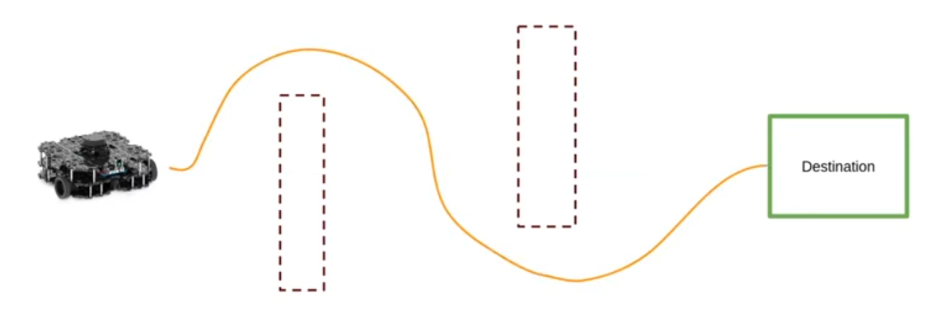
Aim: Robot navigation from A to B
The project aims to develop a system that allows a robot to autonomously navigate from a starting point to a destination with safety and efficiency. This involves real-time responses to environmental changes and obstacles, optimizing its route continuously.

Slide 5
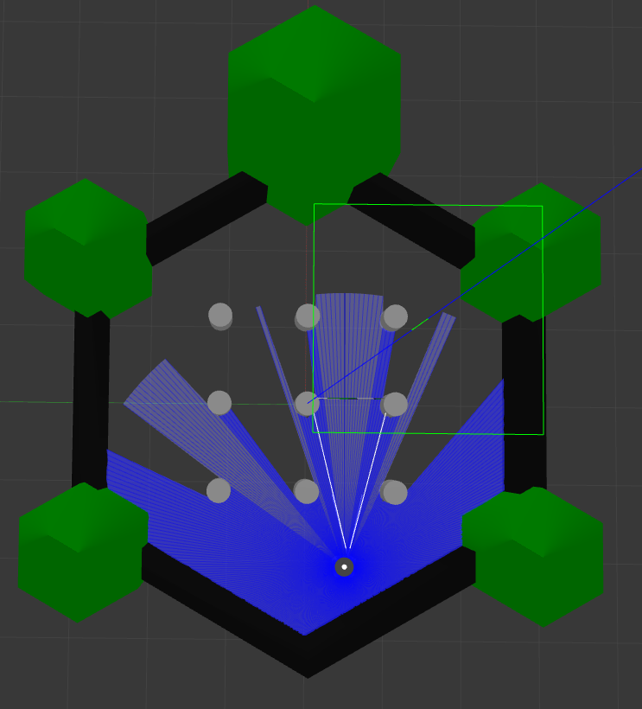


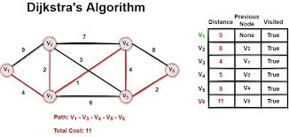
Technologies: ROS2, YOLO, Dijkstra’s, Web API, Quantum
The navigation system employs several cutting-edge technologies: ROS2 for localization, YOLO for obstacle detection, Dijkstra’s algorithm for efficient pathfinding, Web API for real-time tracking, and quantum computing to optimize computations and enhance decision-making capabilities.

Slide 6
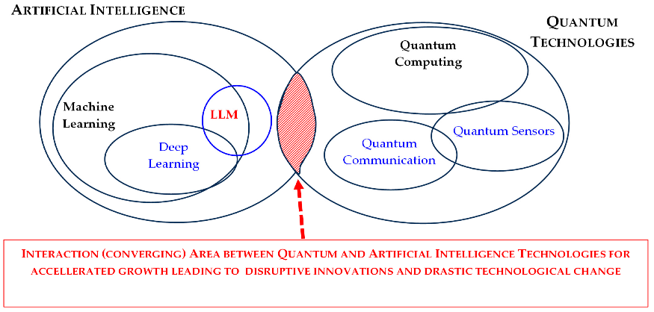
Innovative approach using quantum tech
The integration of quantum technology into autonomous navigation offers significant advantages over classical methods. Quantum algorithms can process vast amounts of data and optimize routing in real-time, enhancing the robot's ability to navigate complex environments quickly. This approach not only improves accuracy but also introduces new levels of intelligence in decision-making processes under uncertainty.

Slide 7
02
Localization with ROS2

Slide 8
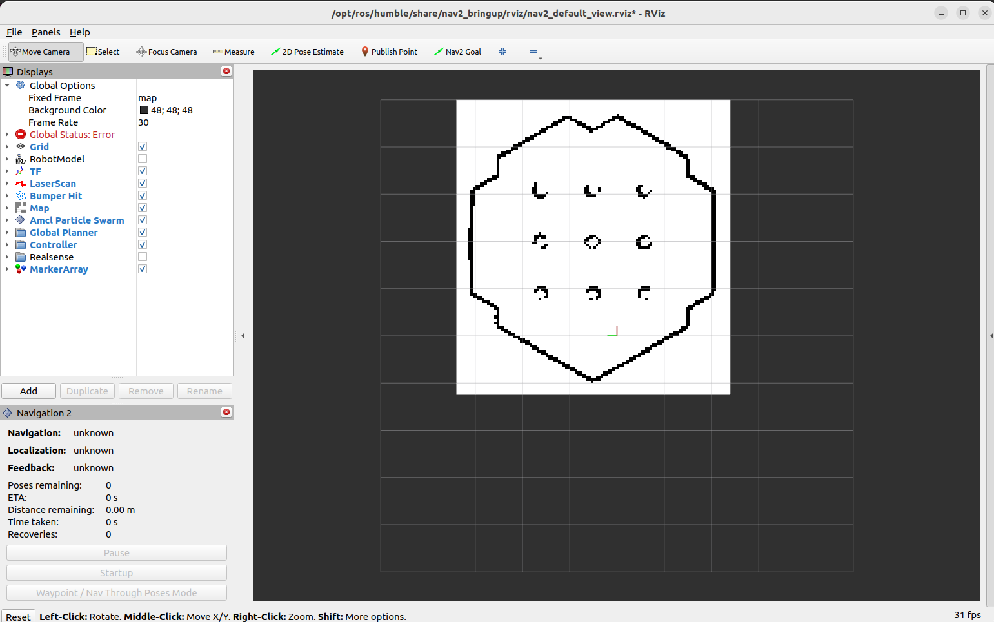
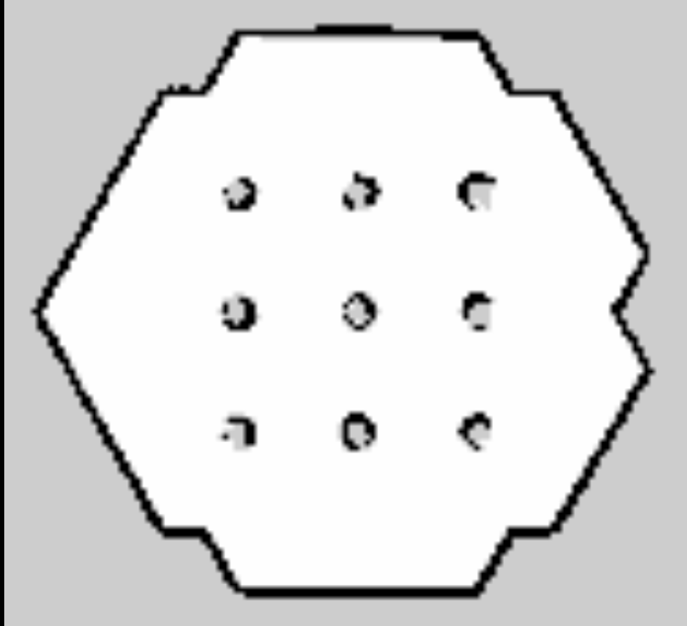
Mapping steps using TurtleBot3 simulation
Mapping begins with launching the TurtleBot3 simulation in ROS2, allowing the robot to explore its environment. The process involves using various parameters to simulate different scenarios, like obstacle presence. By conducting simulations, the robot gathers data to create a comprehensive map of the environment, which is crucial for navigation.

Slide 9
SLAM implementation with Cartographer
Simultaneous Localization and Mapping (SLAM) is implemented using Cartographer in ROS2. This software processes sensor data from the robot, allowing it to build a map while keeping track of its position within that map. The algorithm continually updates the map and localization data in real-time, providing a dynamic navigation experience even in changing environments.

Slide 10
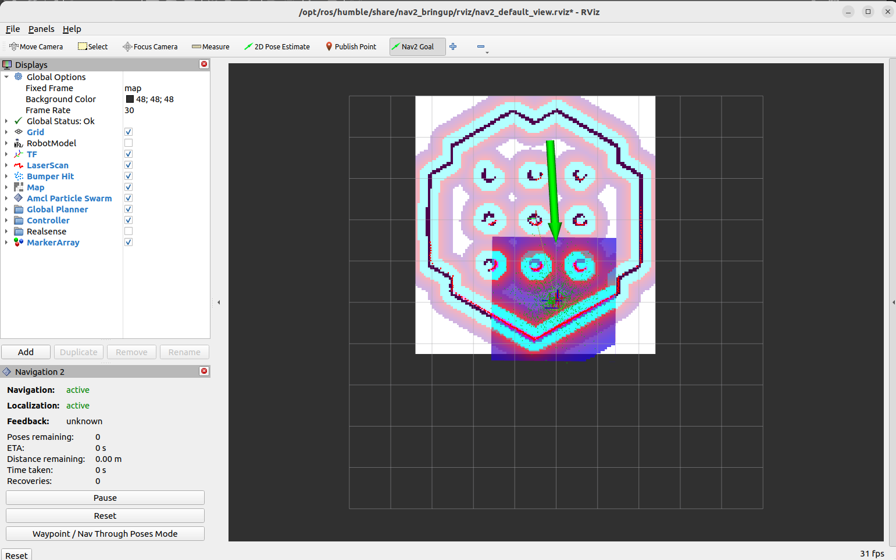
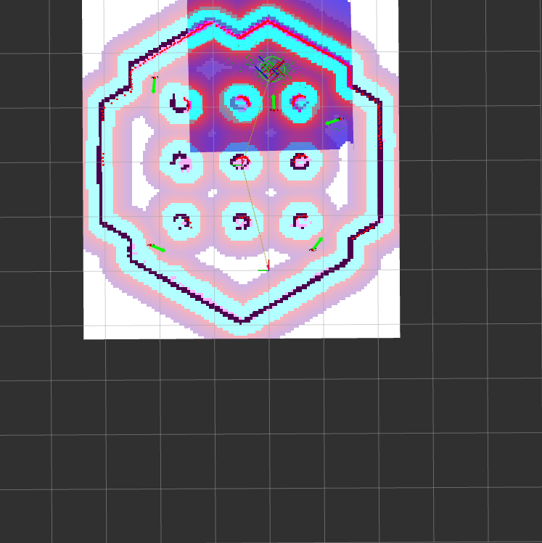
Saving and utilizing the map for navigation
Once the map is created, it is saved for future use, allowing the robot to navigate efficiently. The saved map can be loaded into the navigation stack, enabling the robot to plan paths and navigate autonomously. Advances in map analysis help to optimize routes by identifying potential obstacles in advance, enhancing overall safety and efficiency during navigation.

Slide 11
Conclusions
The project successfully integrates innovative technologies for an advanced quantum-based navigation system. By combining ROS2, machine learning, and quantum computing, the system enhances real-time navigational capabilities, ensuring robots can operate efficiently and safely in complex environments. Continuous improvements and testing will further refine these methods for practical applications.

Slide 12
Thank You

